Slide 1


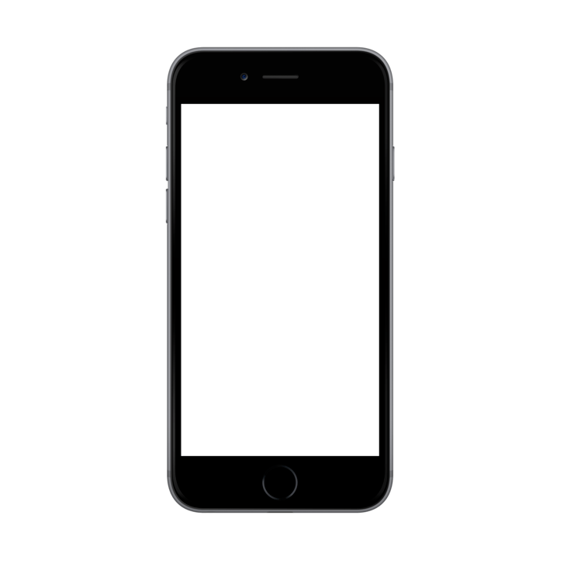
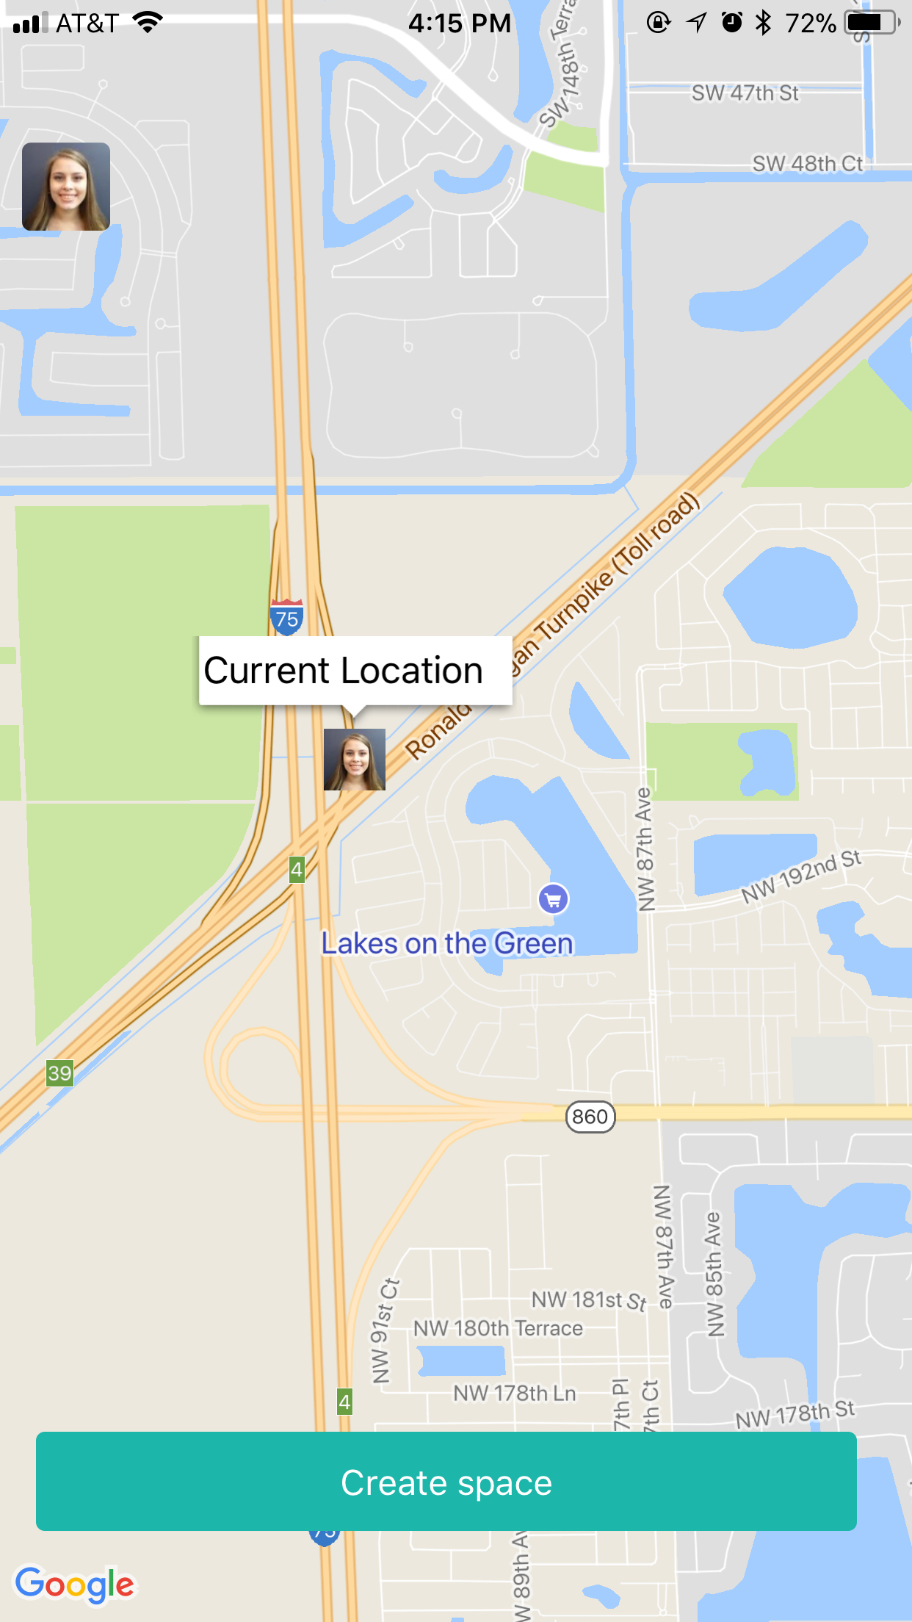
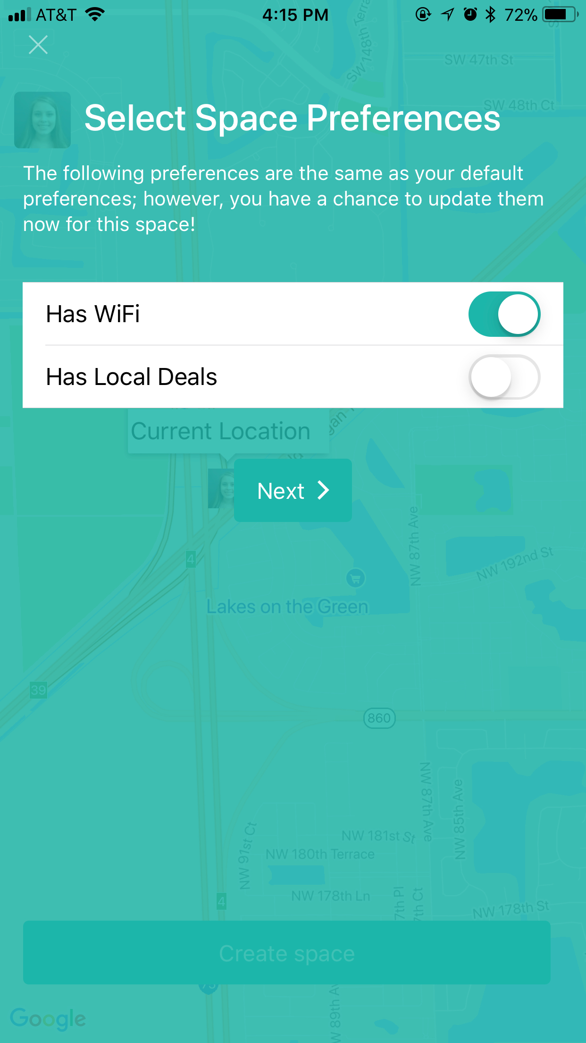
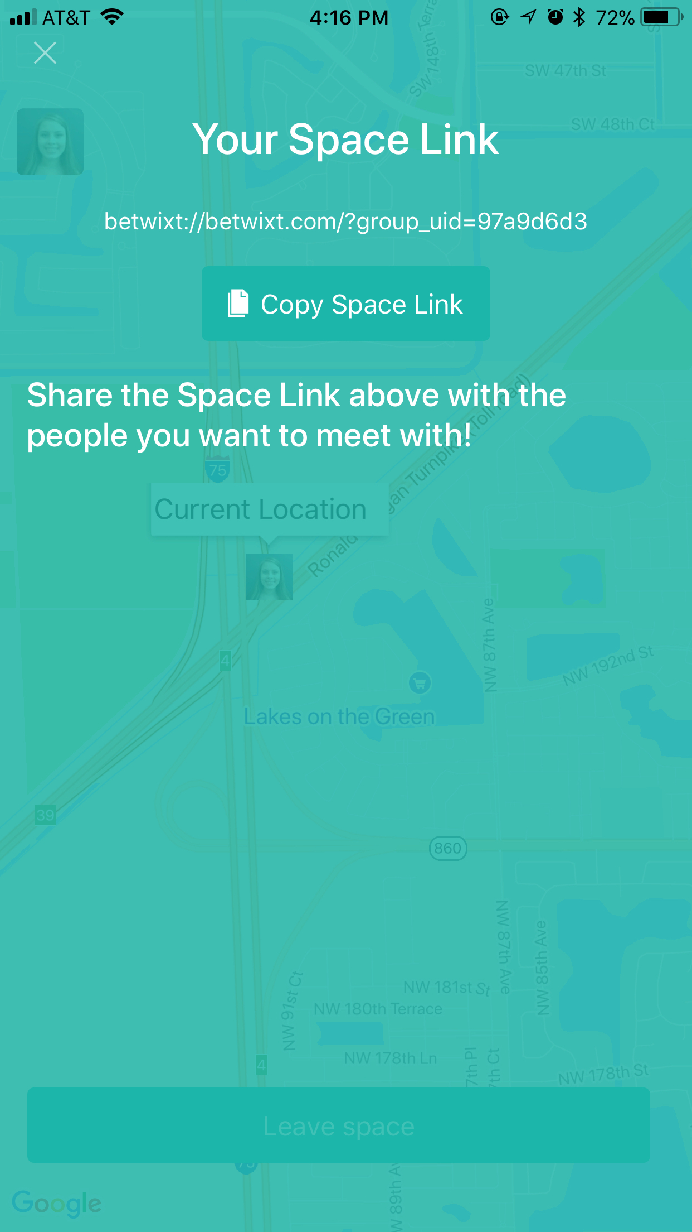
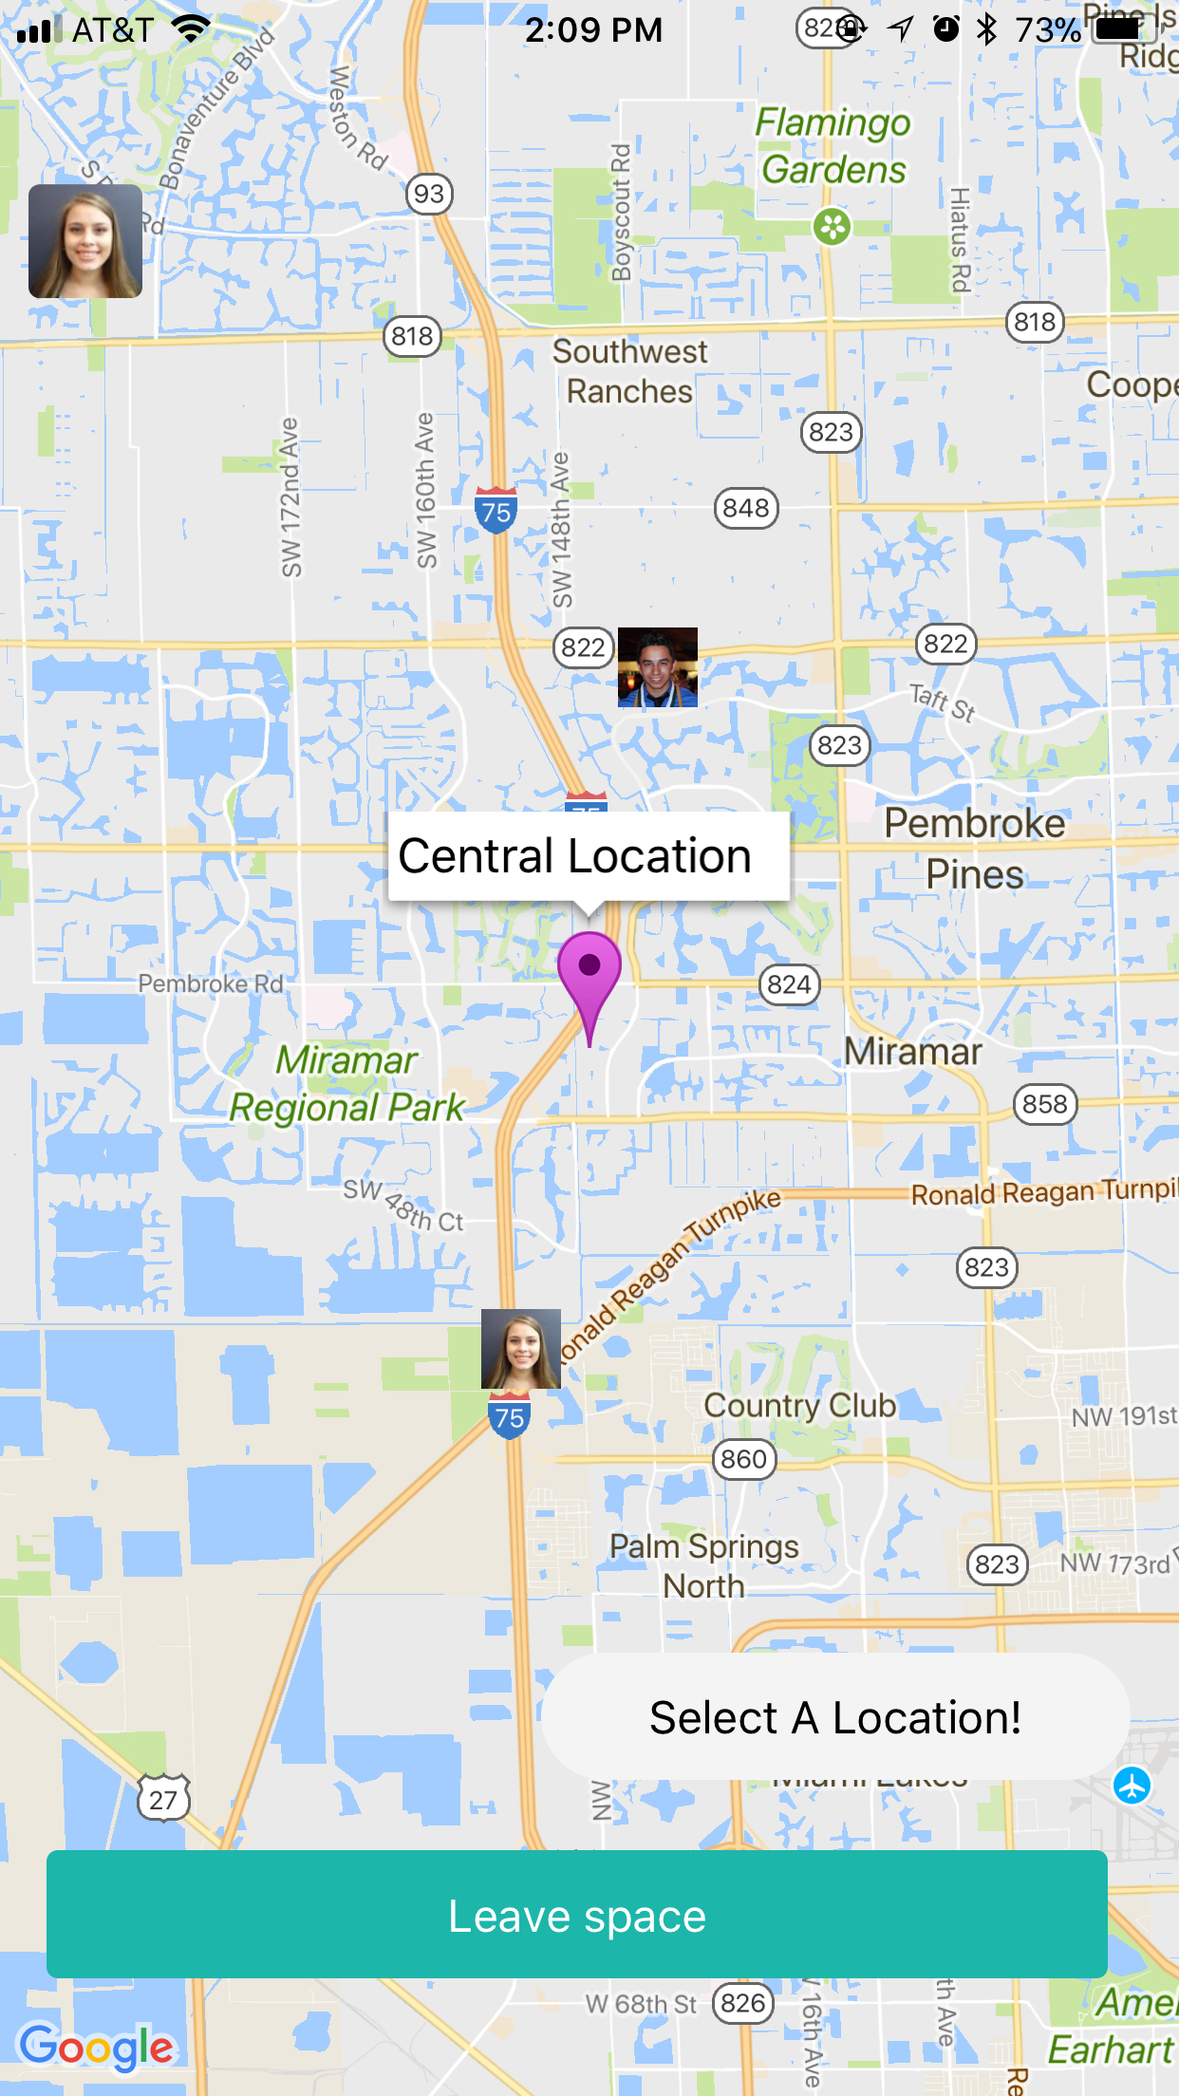
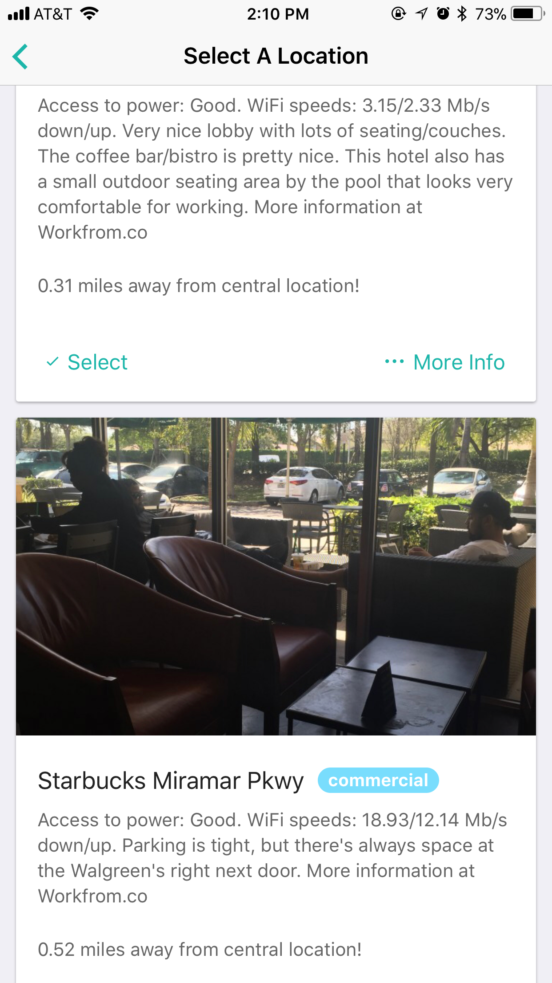
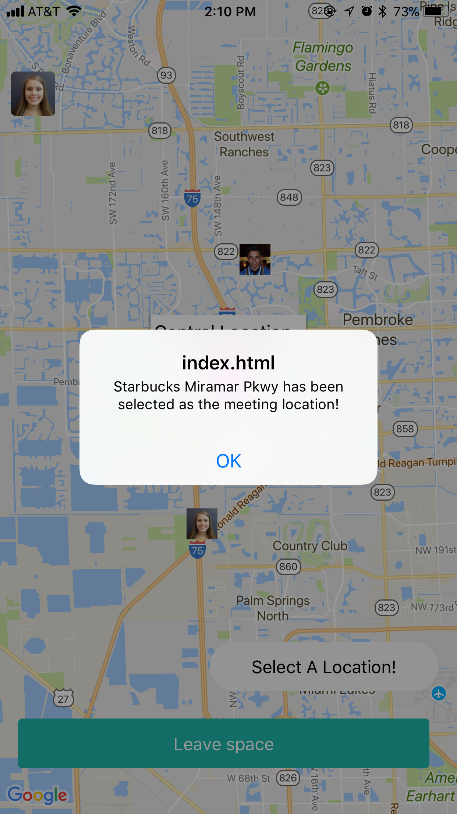
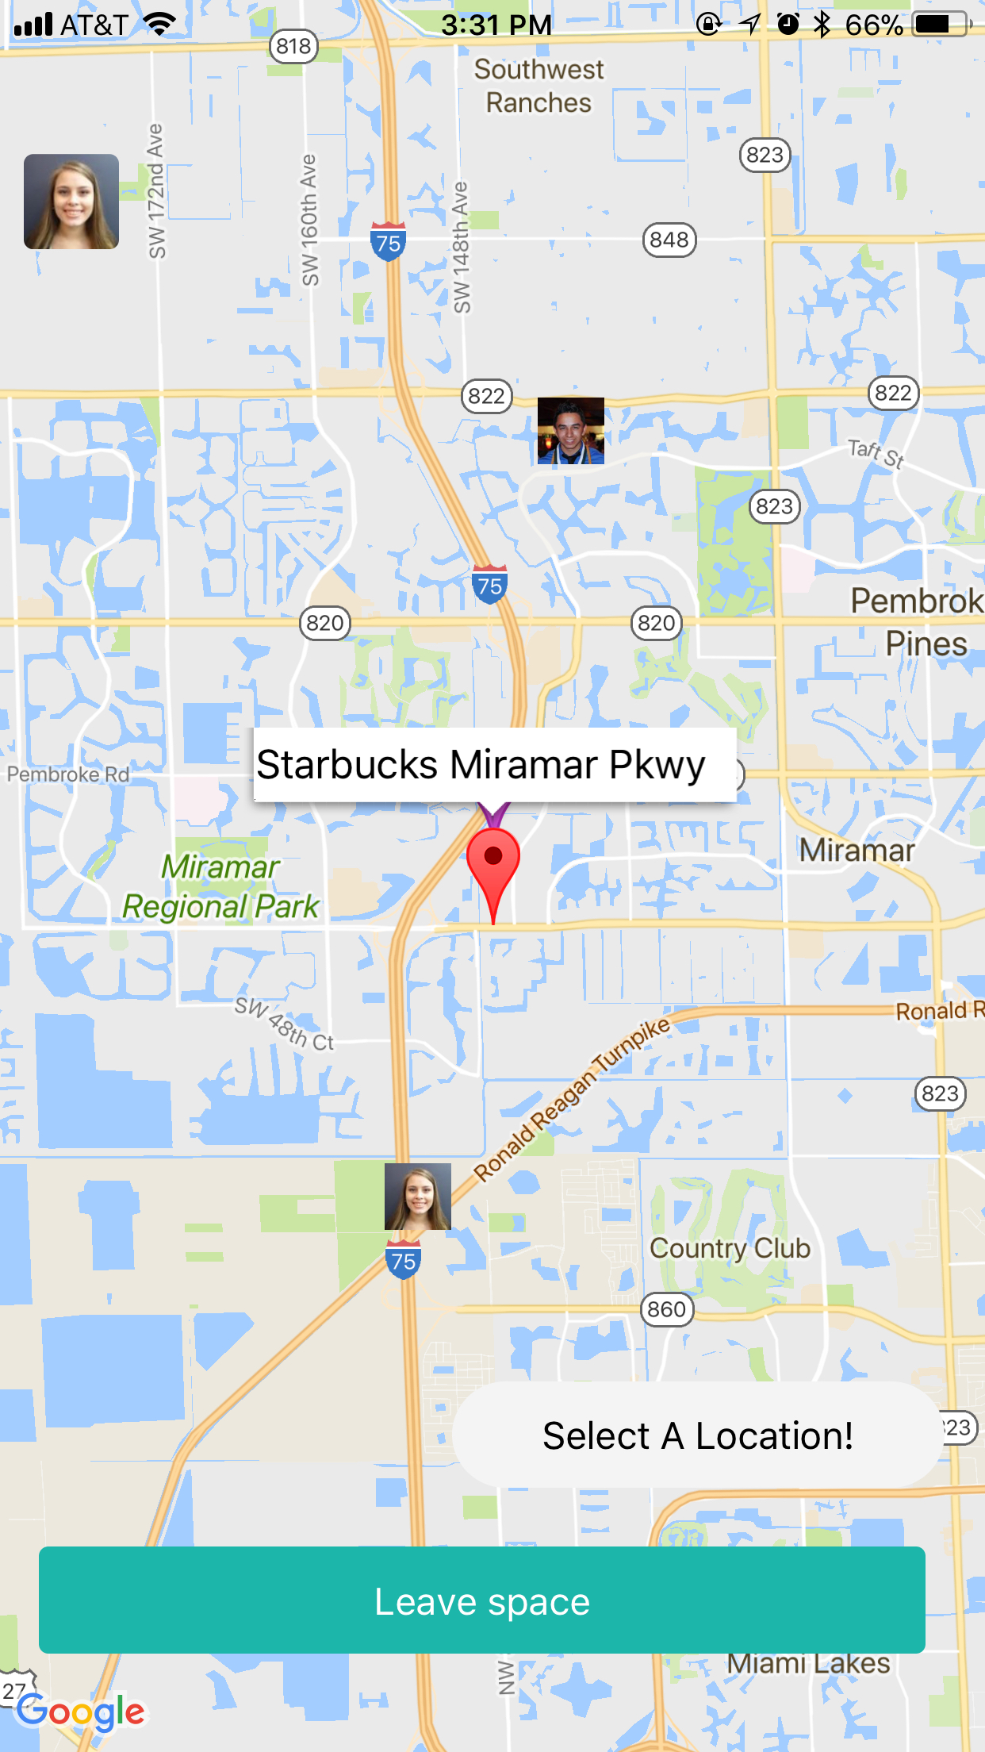
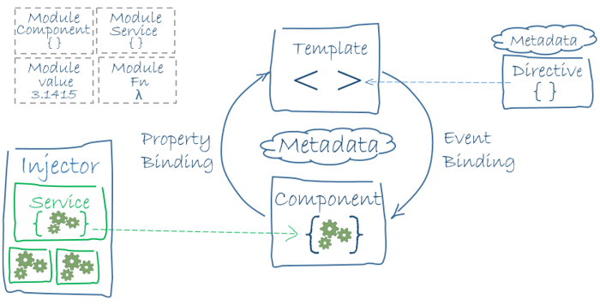












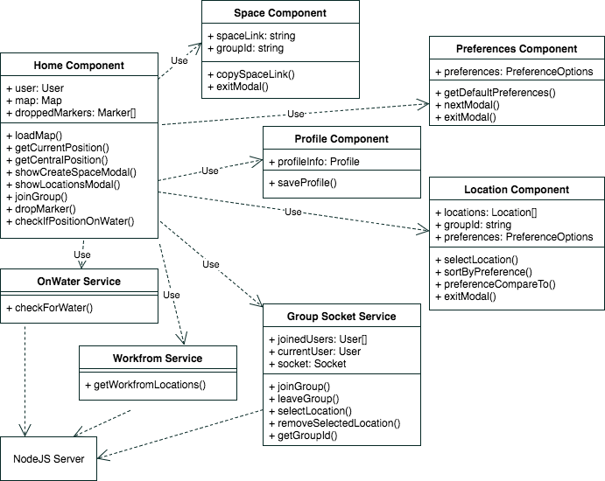



School of Computing & Information Sciences
Senior Project, 2017, Fall
Betwixt 1.0
Student: Alicia Rodriguez, Florida International University
Mentor: Joseph Cutrono, Ultimate Software
Instructor: Masoud Sadjadi, Florida International University
Problem
Solution
Current System
Virtual employees (VE) & their coworkers want a place to meet up
VEs are located across the state and country
It’s difficult to find a location to meet that’s central
A user-friendly and easy-to-use mobile application
Gives VEs a potential location to meet up that’s central amongst their coworkers
An iOS and Android mobile application
Display the central location between VEs and their coworkers
Ability to select a location to meet up
Creating A Space
Selecting A Location
Creating a space for people to join is fast and easy. The space link provided can be distributed to any number of people at any time.
After users have joined the space and the central location has been calculated, the admin of the space can select a location to meet up. If necessary, the admin can select a new location as many times as they want.
Requirements
System Design and Implementation
Support on iOS and Android devices.
Ability for multiple users to join a space, as well as leave it.
Calculate central location between users.
Display the users, central location, and selected location on Google Maps.
Distribute app download link to anyone using PhoneGap.
Front End
Component-Based Architecture
Back End
Client-Server Architecture
Clients
Server
Verification
Object Design
Summary
Manual system testing on iOS and Android devices and Xcode and Android Studio emulators.
Postman used to test HTTPS requests on the server.
A functional iOS and Android mobile application which solves the problem.
VEs and their coworkers are able to see themselves on the app’s map.
The central location and selected location are displayed on the map.
The space admin can select a location to meet up.
Acknowledgements
The material presented in this poster is based upon the work supported by Joseph Cutrono.
I am thankful for the help that I received from my team members, Alejandro Palacios and Daniel Raad.
Notes:
Problem – Solution – Current System
Images
Requirements – System Design – Implementation
Verification – Object Design – Summary
Problem: Virtual employees want an easy way to meet up with a group of their co-workers that are located all around.
Virtual employees (VE) and their coworkers want a place to meet up
VEs are located across the state and country
It is different to find locations to meet it
Solution: An easy to use mobile application which helps virtual employees find a central location and give them a potential location to meet.
User-friendly and easy to use mobile application
Gives VEs a potential location to meet that’s central amongst their coworkers
Current System:
An iOS and Android mobile application
Display the central location between all VEs and their coworkers
Ability to select a location to meet up
…
Requirements:
- The admin of the space can select a new location to meet up
-
System Design:
-
Implementation:
Ionic Framework
NodeJS
*The app is not limited to just South Florida, it works anywhere around the globe.
1

